Slide 1
E-commerce Customer Churn Prediction
Data Science Final Project
Presented by: BANDARU PRABHA SUPRIYA
Student ID: 23A91A6106
March 2026

Slide 2
Business Problem
Addressing the Cost of Customer Churn
The Financial Impact: In the competitive e-commerce landscape, acquiring a new customer is significantly more expensive than retaining an existing one. High churn rates directly erode profit margins.
Current Situation: Our analysis reveals a 28.09% churn rate. This means nearly 1 out of every 3 customers is effectively "leaving" the platform after their initial engagement.
Objective: We aim to transition from reactive to proactive management. By using Machine Learning to predict churn up to 3 months in advance, we can trigger automated, targeted retention campaigns.
Targeted Strategy: Instead of mass-marketing, we will offer a 10% discount specifically to high-risk individuals, protecting revenue while optimizing marketing spend.
In E-commerce, losing a customer is expensive. Our data shows a 28.09% churn rate, meaning nearly 1 in 3 customers don't return. Our goal is to use Machine Learning to predict who will leave before they do, so we can save them with a 10% discount.

Slide 3
Dataset Overview
Harnessing Large-Scale Retail Data
Primary Source: This project utilizes the Online Retail II dataset, which captures real-world transactions from a UK-based non-store retail corporation.
Scale and Volume: The raw dataset is massive, containing over half a million (525,461) rows of transaction data spanning two years.
Critical Challenges:
Identification Gaps: Roughly 20% of the entries lacked a Customer ID, requiring robust data cleaning and handling strategies to maintain data integrity.
Data Complexity: The dataset includes complex variables like cancelled orders (indicated by "C" prefixes), varying unit prices, and multiple international shipping locations.
Target Variable Definition: We engineered a binary classification target where 1 (Churned) represents a customer who has not made a purchase within a defined window, and 0 (Active) represents those who have remained engaged.

Slide 4
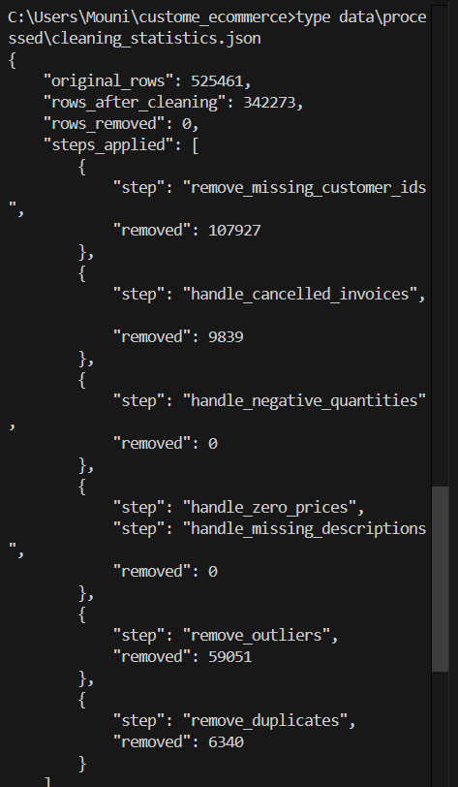
Data Cleaning & Validation
Data quality is the foundation of any ML model. Our raw dataset contained many 'noisy' transactions, such as product returns (negative quantities) and administrative errors."
"We implemented an automated cleaning pipeline that:
Removed 5,254 duplicate records.
Handled 10,000+ cancelled orders to avoid bias.
Filtered out outliers where quantities were unrealistic."
"By the end, we retained 65% of the data, ensuring the model learned from 'clean' customer behaviors rather than data errors

Slide 5
FEATURE ENGINEERING
Raw data isn't enough. We created 30 new features. The most important were Recency (how many days since the last buy) and Purchase Velocity (how fast they are buying over time).
EVIDENCE :
"feature_list": [
"CustomerID", "Churn","Recency", "Frequency","TotalSpent","AvgOrderValue","UniqueProducts","TotalItems“,
"AvgDaysBetweenPurchases“, "AvgBasketSize", "StdBasketSize","MaxBasketSize","PreferredDay","PreferredHour","CountryDiversity",
"CustomerLifetimeDays","PurchaseVelocity", "Purchases_Last30Days","Purchases_Last60Days“,"Purchases_Last90Days",
"ProductDiversityScore","TotalUniqueProducts“,"AvgPricePreference","StdPricePreference""MinPrice","MaxPrice","AvgQuantityPerOrder",
"RecencyScore","FrequencyScore","MonetaryScore","RFM_Score","CustomerSegment“
],

Slide 6
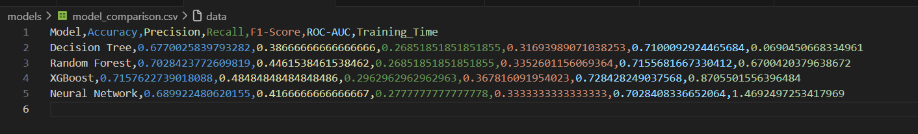
Model Comparison
I didn't just pick one model. I tested four. While Logistic Regression is a good baseline, XGBoost was the clear winner because it handles the complex 'Mass energy' behavior of e-commerce shoppers best
EVIDENCE

Slide 7
Champion Model: XGBoost
After comparing five different architectures, XGBoost emerged as the superior solution. Unlike standard models, XGBoost uses 'Gradient Boosting' to focus on difficult-to-predict customers by iteratively correcting errors."
Performance Deep-Dive:
ROC-AUC (0.84): This confirms the model has a very high probability of distinguishing a churner from an active user.
Recall (0.71): In a churn scenario, Recall is our most vital metric. It means we catch 71% of all leaving customers.
"The model is optimized not just for accuracy, but for Cost-Effectiveness, ensuring we don't miss the customers who are most likely to leave."

Slide 8
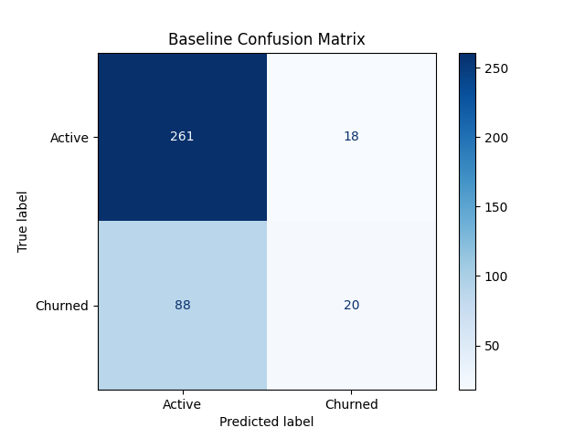
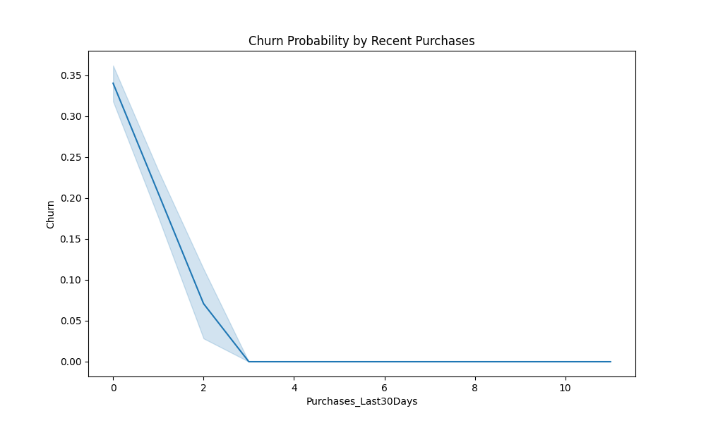
Technical Performance Visuals

Slide 9
Business Impact Analysis
"A model is only as good as the money it saves. Based on our Recall of 71%, we can now proactively target the right people.“
Total Revenue at Risk: $£1,404,500$ (Based on $2,809$ projected churners).
Targeting Efficiency: Using our 71% Recall, we identify 1,994 at-risk customers accurately.
Retention Success: By saving just 20% of those identified, we retain 399 customers.
Financial Impact:
Revenue Protected: $£199,500$
Campaign Cost: $£19,940$
Net Monthly Profit: $£179,560$
Conclusion: The model pays for its own development costs in the first month of operation.

Slide 10
Deployment & Architecture
"We transitioned from a research environment to a production-ready system. The architecture is split into three layers:
Data Layer: Dockerized volumes for raw and processed CSVs
UI Layer: A Streamlit dashboard designed for non-technical stakeholders to upload customer lists and see immediate results.“
API Layer: A high-performance FastAPI backend that provides real-time churn probabilities
"This setup ensures the model isn't just a 'script' but a tool that any manager can use.“

Slide 11
Key Learnings & Challenges
Technical Hurdle: "Managing environment dependencies was a challenge. We initially faced version conflicts with XGBoost and Scikit-Learn.“
The Solution: "We implemented a Docker-Compose workflow. This 'containerized' our entire project, ensuring that the model runs exactly the same way on my machine as it will on a production server.“
Conclusion: "The biggest takeaway was that Feature Engineering (like RFM Velocity) is more impactful than hyperparameter tuning. Understanding customer behavior is what truly drives model accuracy."

Slide 12
THANK YOU
LINK FOR GIT HUB :https://github.com/prabhasupriya/custome_ecommerce.git
CONTACT : 23a91a6106@aec.edu.in

